Slide 1

Engineering Mechanics
Lecture -7

Slide 2
Engineering Mechanics (Problem 1)
A 500-N vertical force is applied to the end of a lever which is attached to a shaft at O. Determine:
moment about O,
horizontal force at A which creates the same moment,
smallest force at A which produces the same moment,
location for a 1200-N vertical force to produce the same moment,
whether any of the forces from b, c, and d is equivalent to the original force.

Slide 3
Engineering Mechanics (Problem 1)

Slide 4
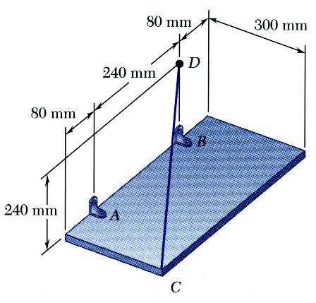
Engineering Mechanics (Problem 2)
The rectangular plate is supported by the brackets at A and B and by a wire CD. Knowing that the tension in the wire is 200 N, determine the moment about A of the force exerted by the wire at C.

Slide 5
Engineering Mechanics (Problem 3)

Slide 6
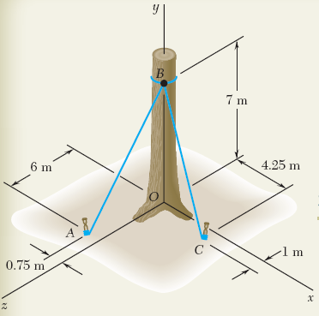
Engineering Mechanics (Problem 3)
Before the trunk of a large tree is felled, cables AB and BC are attached as shown. Tensions in cables AB and BC are 555N and 660N, respectively.
Determine the moment about O of the resultant force exerted on the tree by the cables at B.

Slide 7
Engineering Mechanics (Problem 3)

Slide 8
Engineering Mechanics (Problem 4)
Determine the components of the single couple equivalent to the couples shown.

Slide 9
Engineering Mechanics (Problem 4)

Slide 10
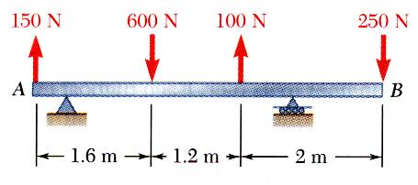
Engineering Mechanics (Problem 5)
For the beam, reduce the system of forces shown to (a) an equivalent force-couple system at A, (b) an equivalent force couple system at B, and (c) a single force or resultant.
Note: Since the support reactions are not included, the given system will not maintain the beam in equilibrium.

Slide 11
Engineering Mechanics (Problem 5)

Slide 12
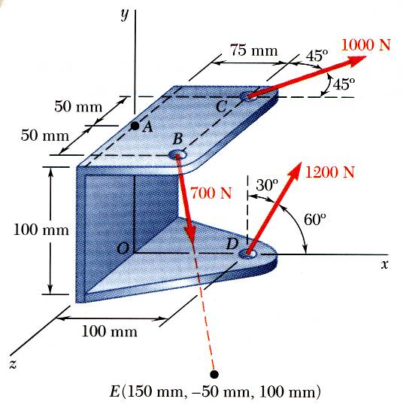
Engineering Mechanics (Problem 6)
Three cables are attached to the bracket as shown. Replace the forces with an equivalent force-couple system at A.

Slide 13
Engineering Mechanics (Problem 6)

Slide 14
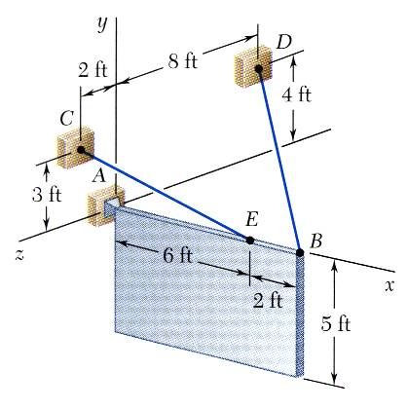
Engineering Mechanics (Problem 7)
A sign of uniform density weighs 270 lb and is supported by a ball-and-socket joint at A and by two cables.
Determine the tension in each cable and the reaction at A.

Slide 15
Engineering Mechanics (Problem 7)

Slide 16
Acknowledgement
NPTEL lectures on Engineering Mechanics
en.wikipedia.org/wiki
britannica.com
Beer & Johnston, Vector Mechanics for Engineers
Meriam & Kraige, Engineering Mechanics
Problems taken from internet sources

Slide 17
Acknowledgement
NPTEL lectures on Engineering Mechanics
en.wikipedia.org/wiki
Beer & Johnston, Vector Mechanics for Engineers
Meriam & Kraige, Engineering Mechanics
Timoshenko & Young, Engineering Mechanics
Problems taken from internet sources

